Slide 1


CSB4301 - WEB TECHNOLOGY
B.Tech – V Semester
Dr. Muthukumaran M
Associate Professor
School of Computing Sciences,
Department of Computer Science and Engineering

Slide 2
Unit 1 - HTML5, CSS3 & BOOTSTRAP
Contents:
HTML: Tags- header, list, table, image, audio & video.
CSS3: colors, box model, Psuedo-classes, Pseudoelements,
Transitions, and Positioning.
Bootstrap4: Buttons, Tables, Images

Slide 3
Unit 1 - HTML5, CSS3 & BOOTSTRAP
Learning outcomes:
Understand and apply different tags of HTML5 with CCS3 1,2,3
2 Use Bootstrap4 on HTML pages

Slide 4

What is the career outlook for web developers?
Web development jobs are projected to increase 15 percent through 2026. That’s more than double the average projected growth rate for all occupations.
“Everyone wants a website”
“As a web developer, you’ll never be short on work.”
Websites have become a critical component for businesses to stay competitive. A company cannot simply utilize a generic online template if it wants to provide a custom, genuine experience for its consumers.
Experienced developers could also try their hand at freelancing or starting their own business.

Slide 5
Lecture 1 - INTRODUCTION
What is Responsive Web Design?
Responsive web design makes your web page look good on all devices.
Designing For The Best Experience For All Users
Web pages can be viewed using many different devices: desktops, tablets, and phones. Your web page should look good, and be easy to use, regardless of the device.

Slide 6
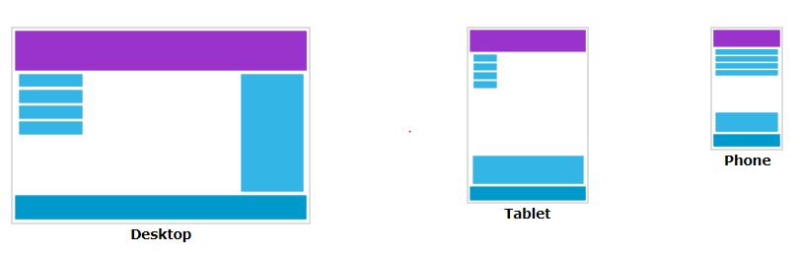
Lecture 1 - INTRODUCTION
Web pages should not leave out information to fit smaller devices, but rather adapt its content to fit any device:

Slide 7

HTML - Introduction
What is HTML?
HTML stands for Hyper Text Markup Language
HTML is the standard Markup language for creating Web pages
HTML describes the structure of a Web page
HTML consists of a series of elements

Slide 8
HTML: Tags- header
<!DOCTYPE html> <html> <head> <title>Page Title</title> </head> <body> <h1>My First Heading</h1> <p>My first paragraph.</p> </body> </html>

Slide 9
HTML: Tags- header
<!DOCTYPE html> declaration defines that this document is an HTML5 document
The <html> element is the root element of an HTML page
The <head> element contains meta information about the HTML page
The <title> element specifies a title for the HTML page (which is shown in the browser's title bar or in the page's tab)
The <body> element defines the document's body, and is a container for all the visible contents, such as headings, paragraphs, images, hyperlinks, tables, lists, etc.
The <h1> element defines a large heading
The <p> element defines a paragraph

Slide 10
POLL

Slide 11
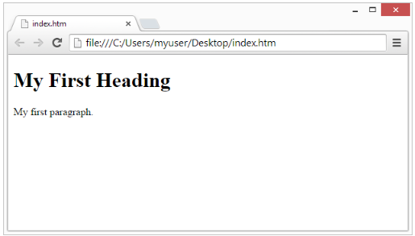
Web Browsers
The purpose of a web browser (Chrome, Edge, Firefox, Safari) is to read HTML documents and display them correctly.
A browser does not display the HTML tags, but uses them to determine how to display the document:

Slide 12
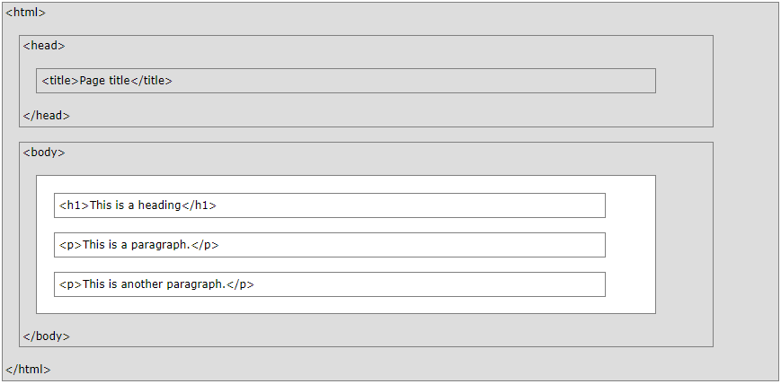
HTML Page Structure

Slide 13
HTML Tags
HTML Headings
HTML headings are defined with the <h1> to <h6> tags.
<h1> defines the most important heading. <h6> defines the least important heading:
<h1>This is heading 1</h1> <h2>This is heading 2</h2> <h3>This is heading 3</h3>
HTML Paragraphs
HTML paragraphs are defined with the <p> tag:
<p>This is a paragraph.</p>

Slide 14
HTML Tags
HTML Links
HTML links are defined with the <a> tag:
<a href="https://www.hindustanuniv.ac.in">This is a link</a>
HTML Images
HTML images are defined with the <img> tag.
The source file (src), alternative text (alt), width, and height are provided as attributes:
<img src="w3schools.jpg" alt="W3Schools.com" width="104" height="142">

Slide 15
HTML Elements
An HTML element is defined by a start tag, some content, and an end tag.
HTML Elements
An HTML element is defined by a start tag, some content, and an end tag:
<tagname>Content goes here...</tagname>
Empty HTML Elements
HTML elements with no content are called empty elements.
The <br> tag defines a line break, and is an empty element without a closing tag:
<p>This is a <br> paragraph with a line break.</p>

Slide 16
HTML Attributes
HTML attributes provide additional information about HTML elements.
All HTML elements can have attributes
Attributes are always specified in the start tag
Attributes usually come in name/value pairs like: name="value“

Slide 17
HTML Attributes
The href Attribute
The <a> tag defines a hyperlink. The href attribute specifies the URL of the page the link goes to:
<a href="https://www.hindustanuniv.ac.in">Visit Hindustan Universitys</a>
The src Attribute
The <img> tag is used to embed an image in an HTML page. The src attribute specifies the path to the image to be displayed:
<img src="img_inkl.jpg">

Slide 18
HTML Attributes - Style
Bigger Headings
Each HTML heading has a default size. However, you can specify the size for any heading with the style attribute, using the CSS font-size property:
<h1 style="font-size:60px;">Heading 1</h1>
HTML Styles
The HTML style attribute is used to add styles to an element, such as color, font, size, and more.
The HTML style attribute has the following syntax:
<tagname style="property:value;">
The property is a CSS property. The value is a CSS value.

Slide 19
HTML Attributes - Style
Background Colour
<body style="background-color : powderblue;"> <h1>This is a heading</h1> <p>This is a paragraph.</p> </body>
Text Color
The CSS color property defines the text color for an HTML element:
<h1 style="color : blue;">This is a heading</h1>
Fonts
The CSS font-family property defines the font to be used for an HTML element:
<h1 style="font-family : verdana;">This is a heading</h1>

Slide 20
HTML Attributes - Style
Text Size
The CSS font-size property defines the text size for an HTML element:
<h1 style="font-size:300%;">This is a heading</h1>
Text Alignment
The CSS text-align property defines the horizontal text alignment for an HTML element:
<h1 style="text-align:center;">Centered Heading</h1>

Slide 21
HTML Formatting Elements
Formatting elements were designed to display special types of text:
<b> - Bold text
<strong> - Important text
<i> - Italic text
<em> - Emphasized text
<mark> - Marked text
<small> - Smaller text
<del> - Deleted text
<ins> - Inserted text
<sub> - Subscript text
<sup> - Superscript text
<p>Do not forget to buy <mark>milk</mark> today.</p>
<p>My favorite color is <del>blue</del> <ins>red</ins>.</p>

Slide 22
Practice Exercises
Create a webpage that prints your name to the screen.
<html>
<body>
<!-- print name to the screen -->
John
</body>
</html>

Slide 23
Practice Exercises
Create a webpage that prints any text of your choosing to the screen, do not include a head section in the code.
<html>
<!--there is no head section in this HTML code-->
<body>
<!--print a message-->
The giraffe is a very interesting animal.
</body>
</html>

Slide 24
Practice Exercises
Print your name in green.
<html>
<body>
<font color="green">John</font>
</body>
</html>

